Slide 1
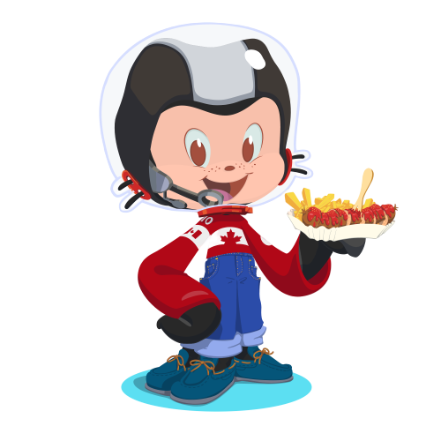

Welcome
To
<First/ >
Cookies & Code: GitHub Basic
Notes:
Welcome to wits first cookie and code!

Slide 2


What's the difference?
Git is a version control system.
It can be used with various tools or locally on your computer to help you keep track of changes in your code projects.
GitHub is a platform for code collaboration!
GitHub uses Git for version control and provides you all sorts of awesome collaboration tools.
Notes:
Git:
Explain what a version control is:
GitHub:
Read from the slides So, what makes GitHub so special? Git is a command-line tool, but the center around which all things involving Git revolve is the hub—GitHub.com—where developers store their projects and network with like minded people.
Also it an amazing platform to showcase your projects that you have worked on, so recruiters can read through your code Let’s go over a few of the main reasons that geeks like to use GitHub, and learn some terminology along the way.

Slide 3
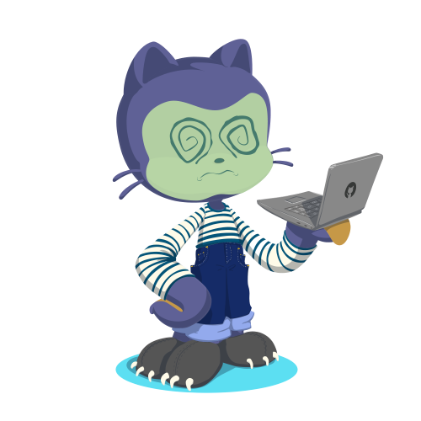
Key Words, Terminologies, & Headaches
Notes:
“Let’s go over some keywords and often Git can seem intimidating and WARNING: it will make you like you are concussed after looking these flowcharts.” *Open Link on headache while speaking this* Before going on to terminologies - I want you to go ahead and create a github account if you do not already have one - if you do, you may want to sign into your account at this point .

Slide 4
Workflow Terminologies
You're going to practice a typical best practice developer workflow.
First, you'll fork someone else's code. This means creating your own copy of it.
Then you'll create a branch. The branch is a parallel version of your copy, where you'll test your own changes.
Key Terms
fork: your own copy of someone else's repository.
branch: a parallel version of the master copy of a repo. Making a branch allows you to edit code without accidentally breaking a working version
Notes:
When you create a branch off the main branch, you’re making a copy, or snapshot, of main as it was at that point in time. If someone else made changes to the main branch while you were working on your branch, you could pull in those updates.

Slide 5
Workflow Terminologies
You stage your changes as you go. When you're happy with them, you'll commit them.
If you want to add your code to someone else's project, you'll open a pull request.
If they approve it, they'll merge your branch into their master branch.
Key Terms
stage: add to a cohesive group/bundle of revisions
commit: a group of revisions you want to officially add to your branch
merge: to officially add the changes from your branch into the master branch (or another branch)

Slide 6



Use the staging area to build a commit
Repository Final draft, permanent
git commit
Staging Area Your rough draft
git add
Working Directory Your workspace, local on your machine

Slide 7

Github Page to Contribute on - https://github.com/JankiChaudhari226/my-first-commit.github.io
Notes:
Github Page to Contribute on - https://github.com/JankiChaudhari226/my-first-commit.github.io
Page that will display the live changes - https://jankichaudhari226.github.io/my-first-commit.github.io/

Slide 8
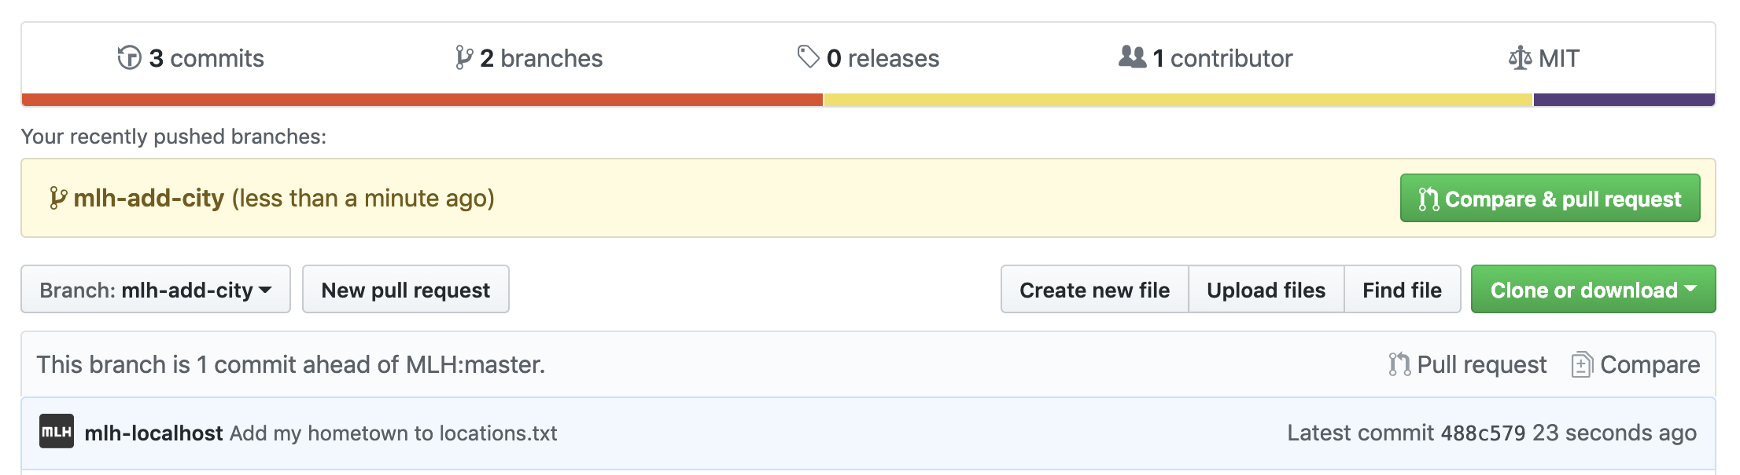
Go to main page
Make a pull request

Slide 9
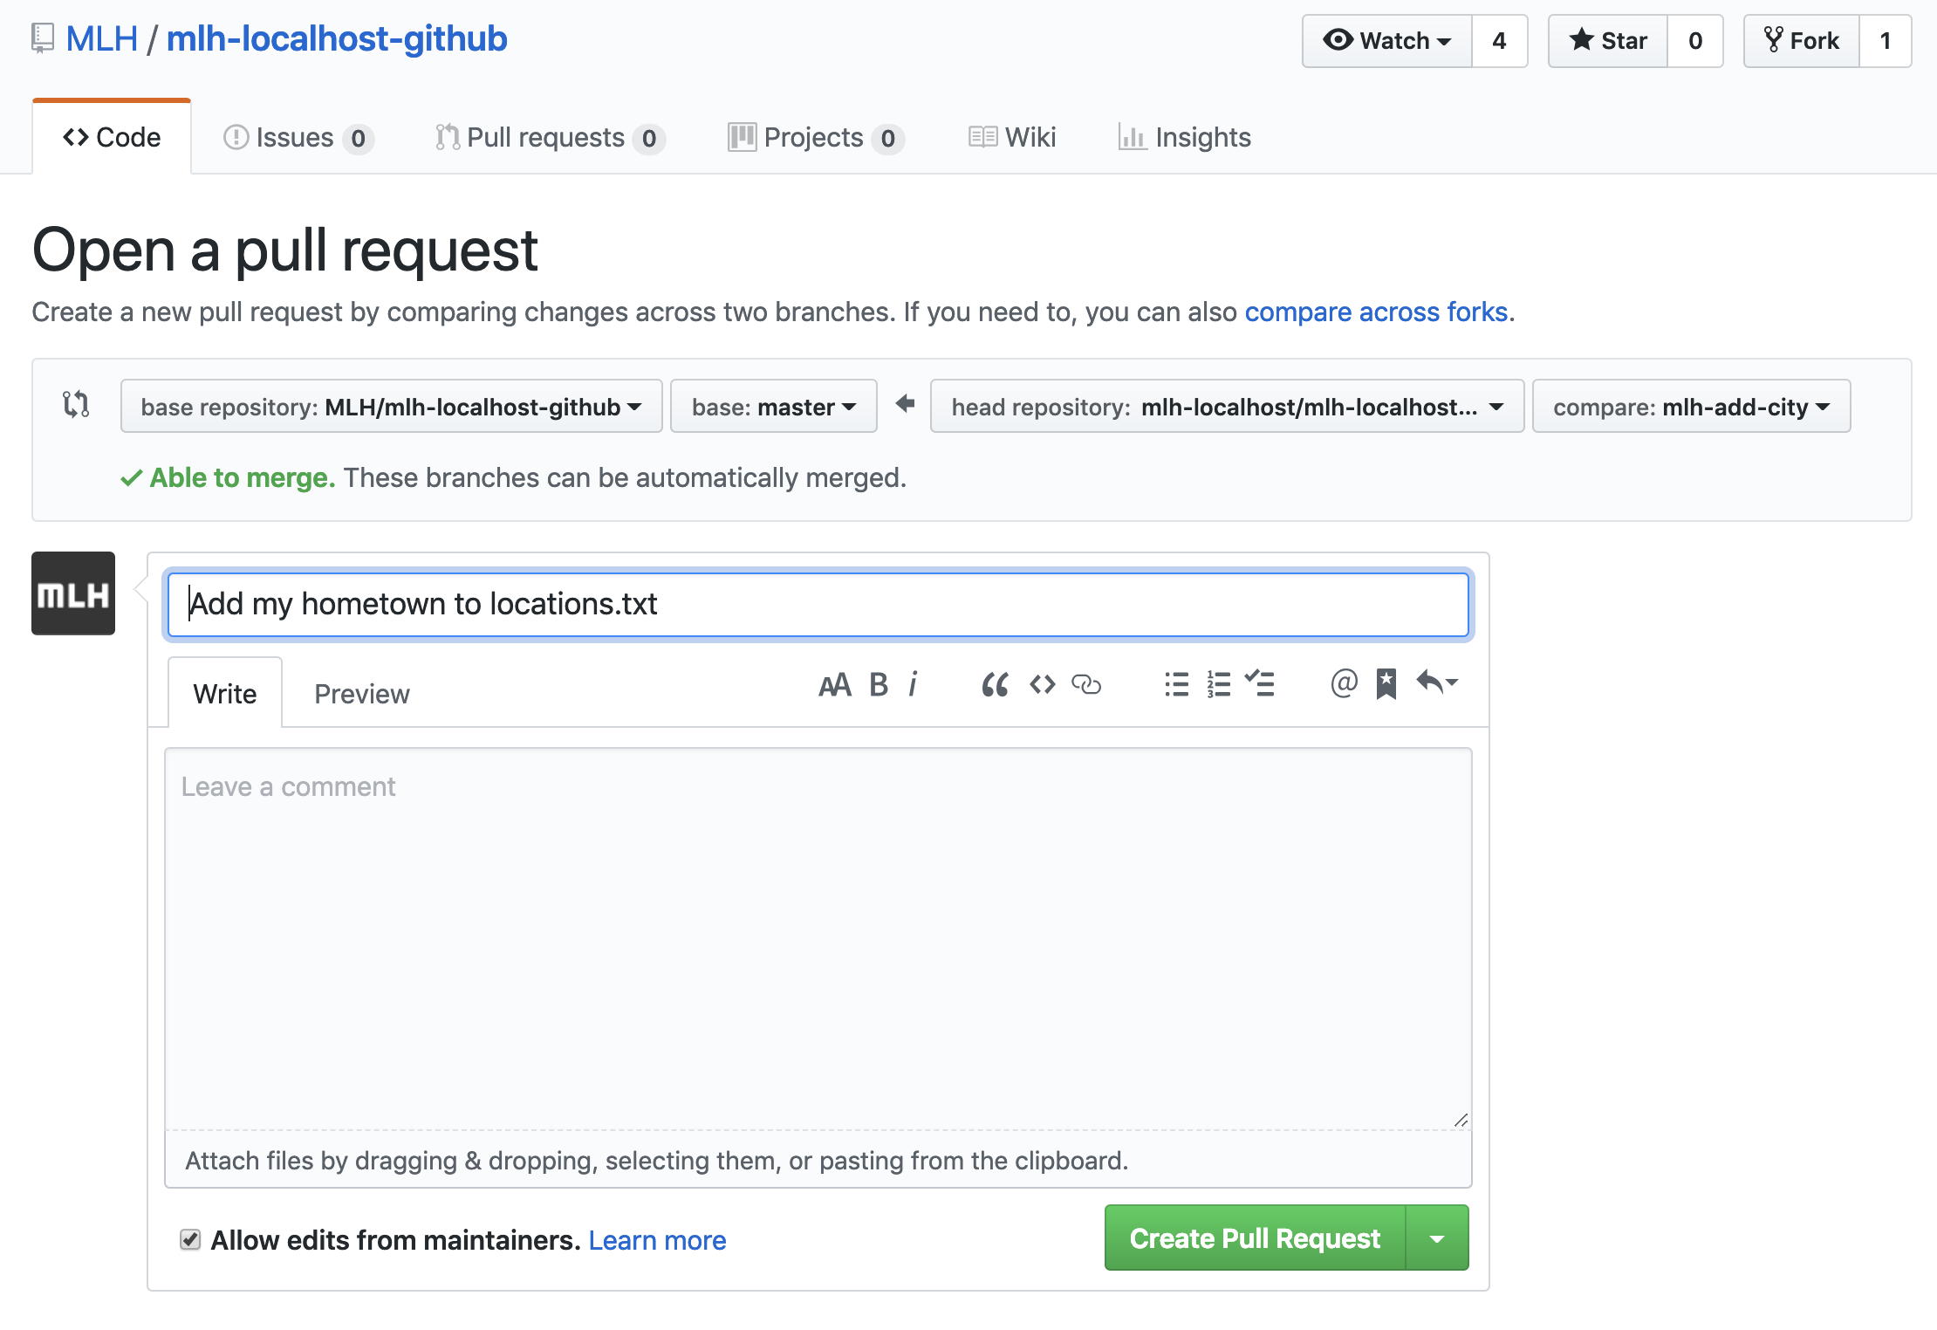

Slide 10
Project: Hello World
Create and use a repository
Start and manage a new branch
Make changes to a file and push them to GitHub as commits
Open and merge a pull request
Notes:
https://guides.github.com/activities/hello-world/

Slide 11

Resources
GitHub Guide: Introduction
Install GIT for mac OS
Installing GIT for Windows Machine
GIT handbook
Hosting on Github Pages
Build your own octocat
Notes:
We will post the slides on our fb page

